Slide 1
Lecture 5:
Closed Loop Op-amp configurations

Slide 2
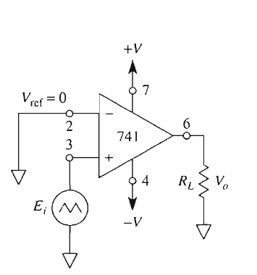
Basic Op-Amp Configurations
Open-loop Configurations
Comparator / Voltage Level Detectors
Closed Loop Configurations
Voltage Follower
Inverting Amplifier
Inverting Summer
Non-Inverting Amplifier
Weighted Subtractor
Integrator
Differentiator
Exponential Converter
Logarithmic Converter
Multiplier
Divider

Slide 3
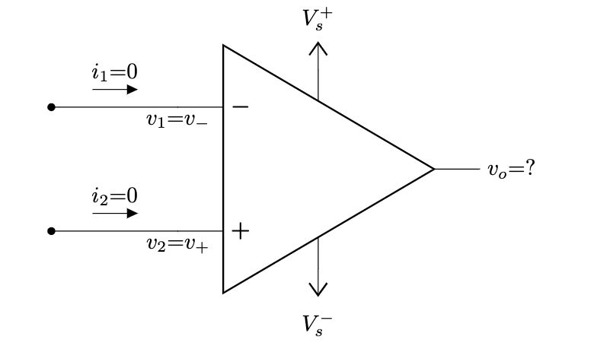
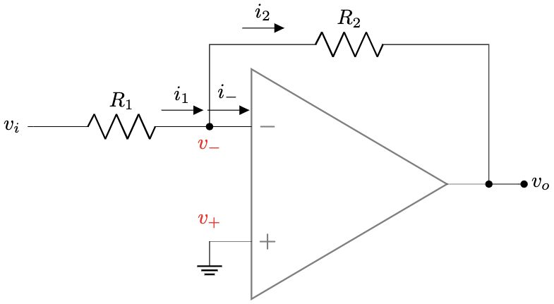
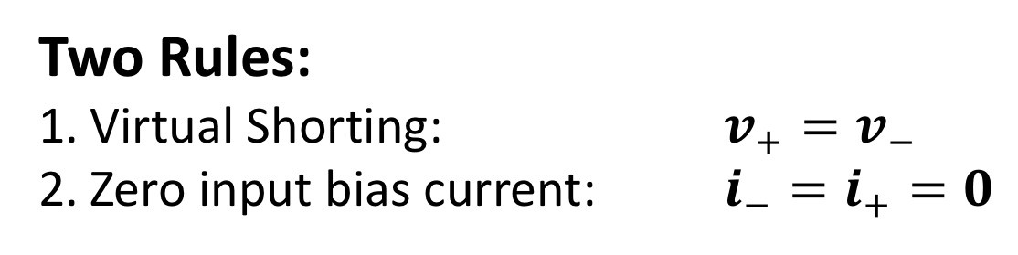
Solving Closed Loop Op-Amp Circuit
Two Rules:
Virtual Shorting: $v_{+}=v_{−}$
Zero input bias current: $i_{−}=i_{+}=0$

Slide 4
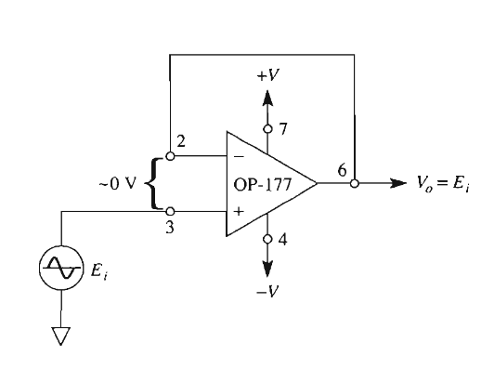

Voltage Follower / Buffer:
$$V_{O}=E_{i}$$

Slide 5
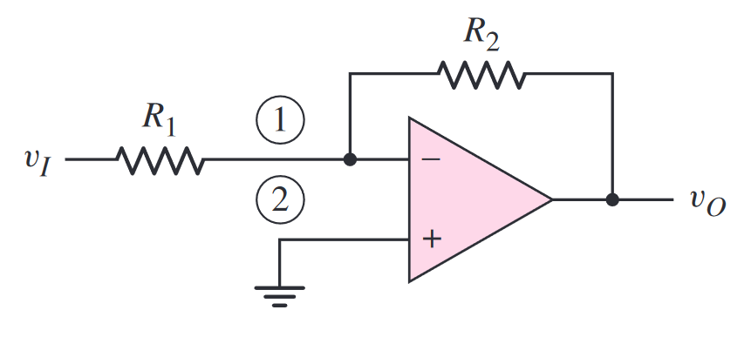

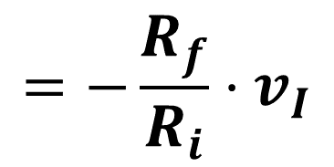

Inverting Amplifier
$$R_{f}$$
$$R_{i}$$
$$=−\frac{R_{f}}{R_{i}}⋅v_{I}$$

Slide 6
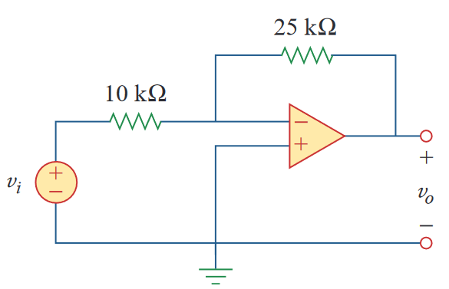
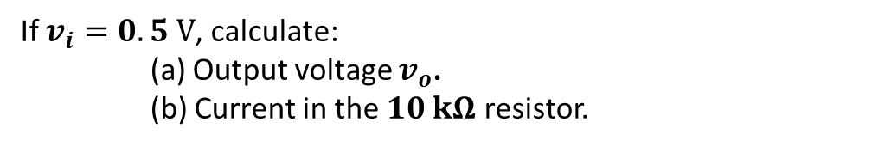
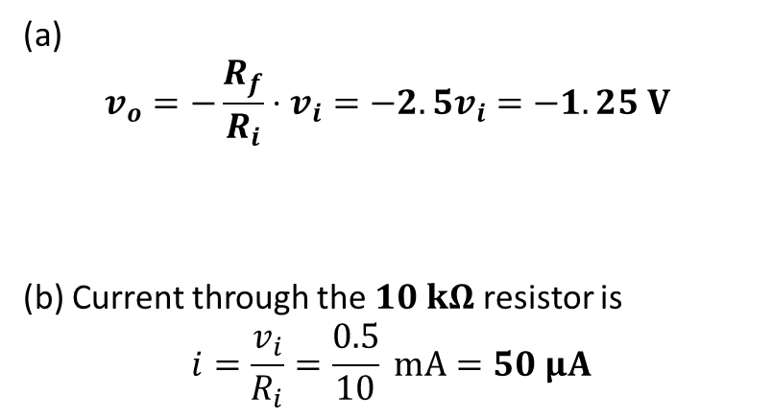
Example - 1
If $v_{i}=0.5 V$, calculate:
(a) Output voltage $v_{o}$.
(b) Current in the $10 kΩ$ resistor.
(a)
$$v_{o}=−\frac{R_{f}}{R_{i}}⋅v_{i}=−2.5v_{i}=−1.25 V$$
(b) Current through the $10 kΩ$ resistor is
$$i=\frac{v_{i}}{R_{i}}=\frac{0.5}{10} mA=50 μA$$

Slide 7
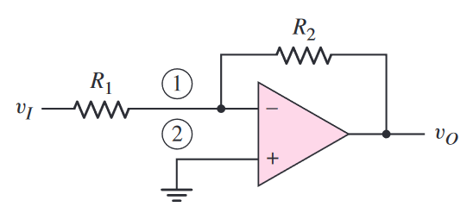
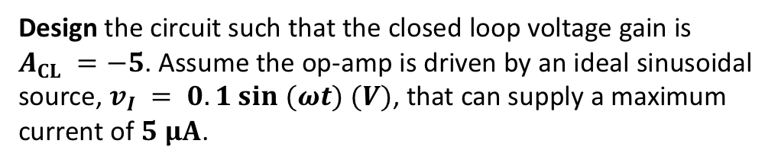

Example - 2
Design the circuit such that the closed loop voltage gain is $A_{CL} =−5$. Assume the op-amp is driven by an ideal sinusoidal source, $v_{I} = 0.1 sin (ωt) (V)$, that can supply a maximum current of $5 μA$.
$$i_{1}$$

Slide 8
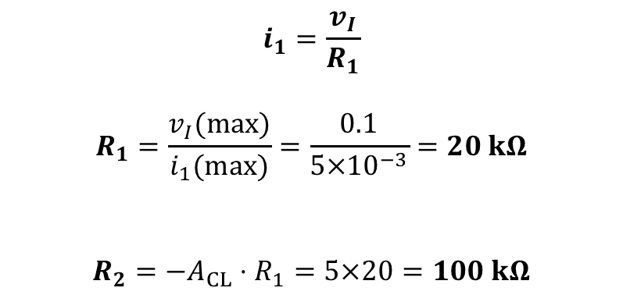
Example - 2
Design the circuit such that the closed loop voltage gain is $A_{CL} =−5$. Assume the op-amp is driven by an ideal sinusoidal source, $v_{I} = 0.1 sin (ωt) (V)$, that can supply a maximum current of $5 μA$.
$$i_{1}=\frac{v_{I}}{R_{1}}$$
$$R_{1}=\frac{v_{I}(max)}{i_{1}(max)}=\frac{0.1}{5×10^{−3}}=20 kΩ$$
$$R_{2}=−A_{CL}⋅R_{1}=5×20=100 kΩ$$
$$i_{1}$$

Slide 9
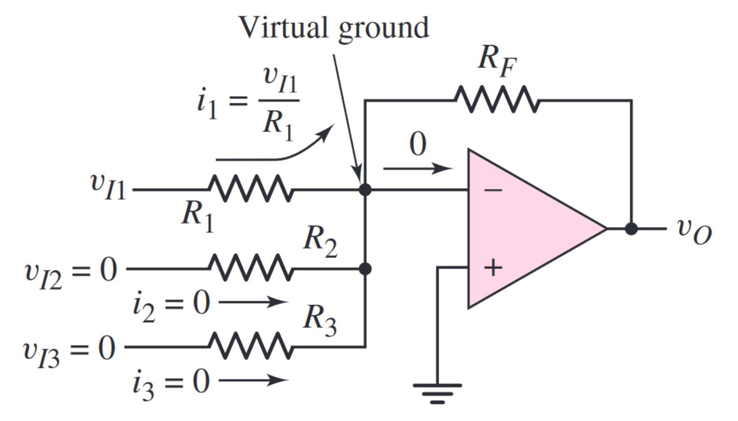
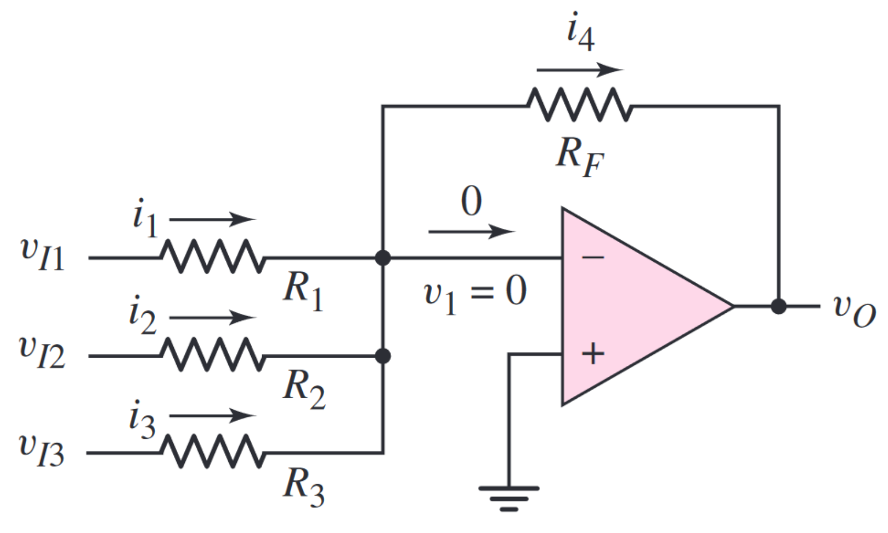
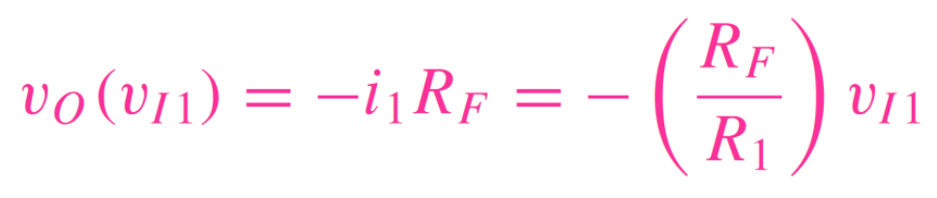
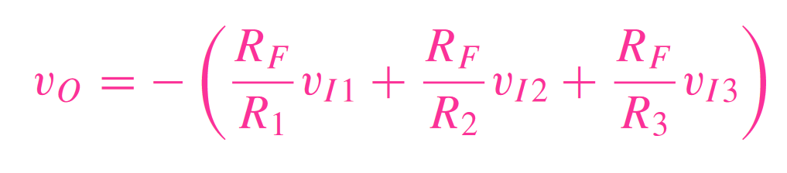
Inverting Summer
Multichannel Amplifier

Slide 10
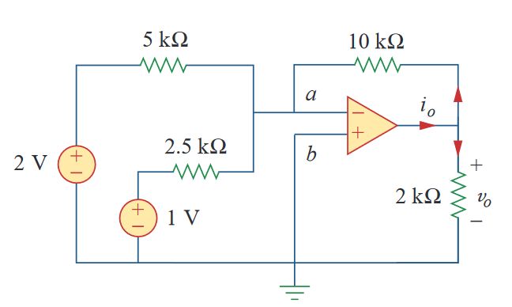
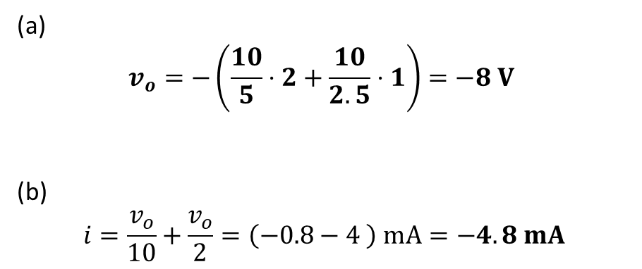
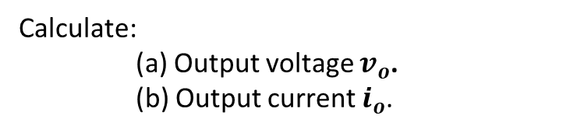
Example - 3
Calculate:
(a) Output voltage $v_{o}$.
(b) Output current $i_{o}$.
(a)
$$v_{o}=−\left(\frac{10}{5}⋅2+\frac{10}{2.5}⋅1\right)=−8 V$$
(b)
$$i=\frac{v_{o}}{10}+\frac{v_{o}}{2}=\left(−0.8−4 \right) mA=−4.8 mA$$

Slide 11
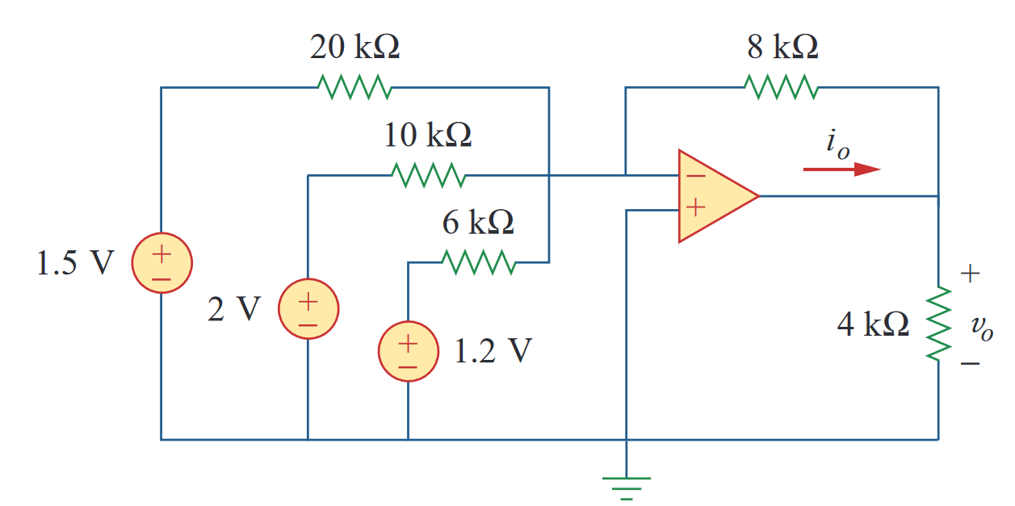
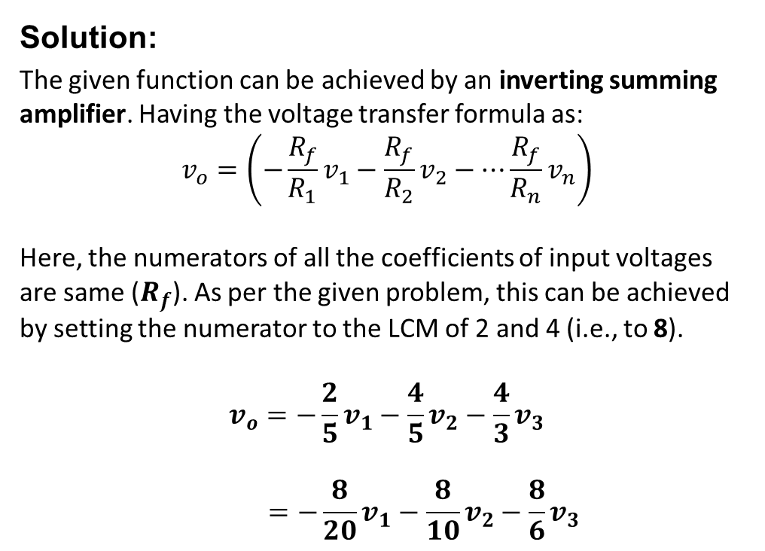

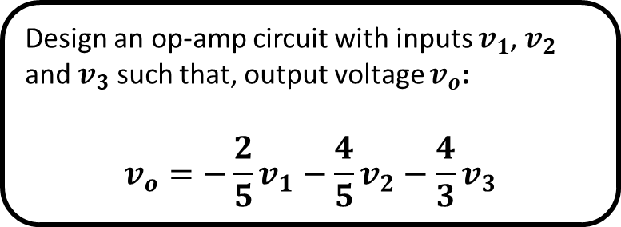


Example 4
Solution:
The given function can be achieved by an inverting summing amplifier. Having the voltage transfer formula as:
$$v_{o}=\left(−\frac{R_{f}}{R_{1}}v_{1}−\frac{R_{f}}{R_{2}}v_{2}−⋯\frac{R_{f}}{R_{n}}v_{n}\right)$$
Here, the numerators of all the coefficients of input voltages are same ($R_{f}$). As per the given problem, this can be achieved by setting the numerator to the LCM of 2 and 4 (i.e., to 8).
$$v_{o}=−\frac{2}{5}v_{1}−\frac{4}{5}v_{2}−\frac{4}{3}v_{3}$$
$$=−\frac{8}{20}v_{1}−\frac{8}{10}v_{2}−\frac{8}{6}v_{3}$$
Design an op-amp circuit with inputs $v_{1}$, $v_{2}$ and $v_{3}$ such that, output voltage $v_{o}$:
$$v_{o}=−\frac{2}{5}v_{1}−\frac{4}{5}v_{2}−\frac{4}{3}v_{3}$$
$$v_{1}$$
$$v_{2}$$
$$v_{2}$$

Slide 12

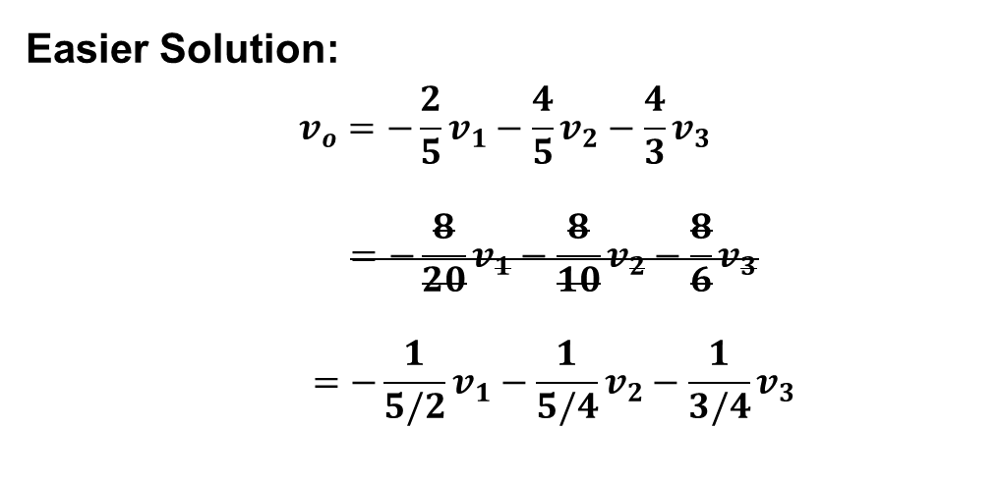






Example 4
Easier Solution:
$$v_{o}=−\frac{2}{5}v_{1}−\frac{4}{5}v_{2}−\frac{4}{3}v_{3}$$
$$=−\frac{8}{20}v_{1}−\frac{8}{10}v_{2}−\frac{8}{6}v_{3}$$
$$=−\frac{1}{5/2}v_{1}−\frac{1}{5/4}v_{2}−\frac{1}{3/4}v_{3}$$
Design an op-amp circuit with inputs $v_{1}$, $v_{2}$ and $v_{3}$ such that, output voltage $v_{o}$:
$$v_{o}=−\frac{2}{5}v_{1}−\frac{4}{5}v_{2}−\frac{4}{3}v_{3}$$
$$5/2$$
$$1$$
$$5/4$$
$$v_{1}$$
$$3/4$$
$$v_{2}$$
$$v_{2}$$

Slide 13
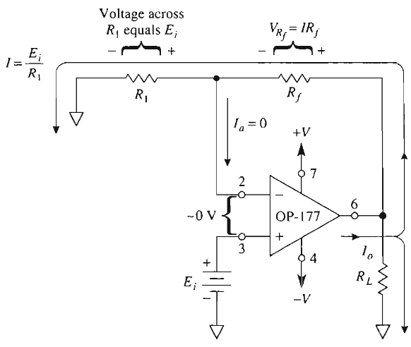
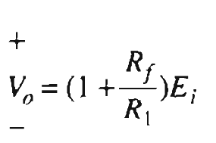
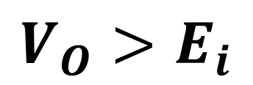
Non-Inverting Amplifier
$$V_{O}>E_{i}$$

Slide 14
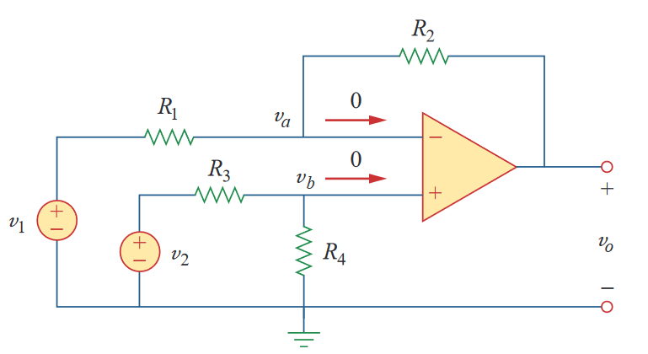

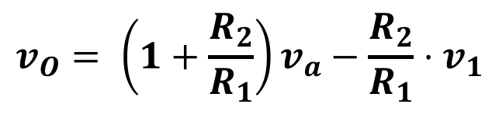
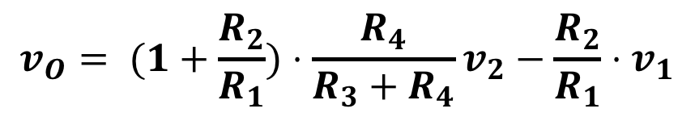

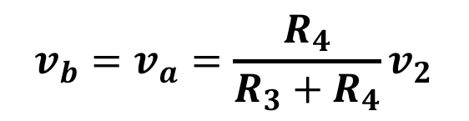
Difference Amplifier
$${v_{b}=v}_{a}=\frac{R_{4}}{R_{3}+R_{4}}v_{2}$$
$$v_{O}= \left(1+\frac{R_{2}}{R_{1}}\right)v_{a}−\frac{R_{2}}{R_{1}}⋅v_{1}$$
$$v_{O}= (1+\frac{R_{2}}{R_{1}})⋅\frac{R_{4}}{R_{3}+R_{4}}v_{2}−\frac{R_{2}}{R_{1}}⋅v_{1}$$

Slide 15
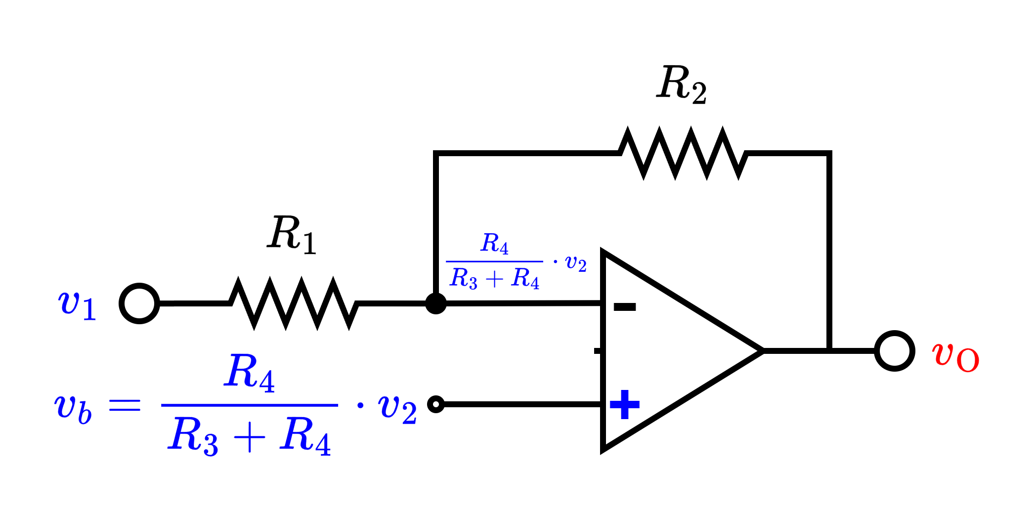

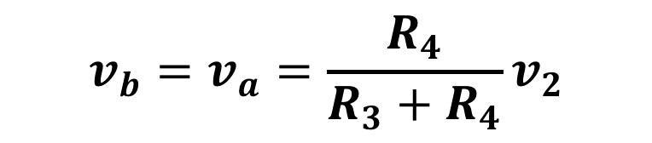

Difference Amplifier
Simplified Circuit
$${v_{b}=v}_{a}=\frac{R_{4}}{R_{3}+R_{4}}v_{2}$$

Slide 16
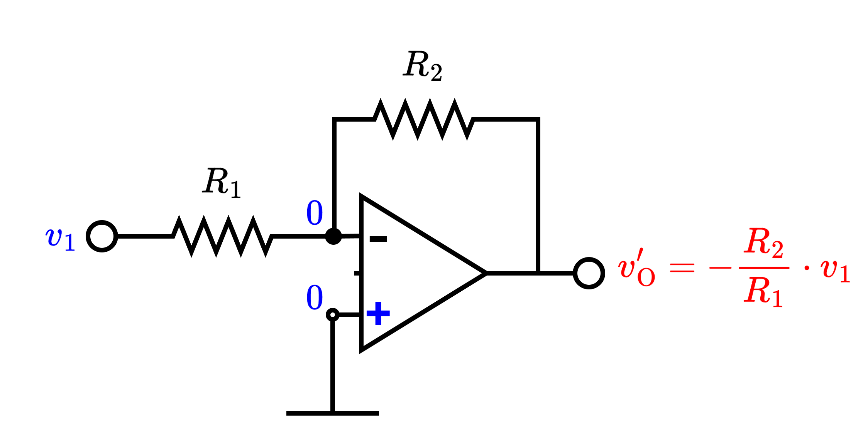
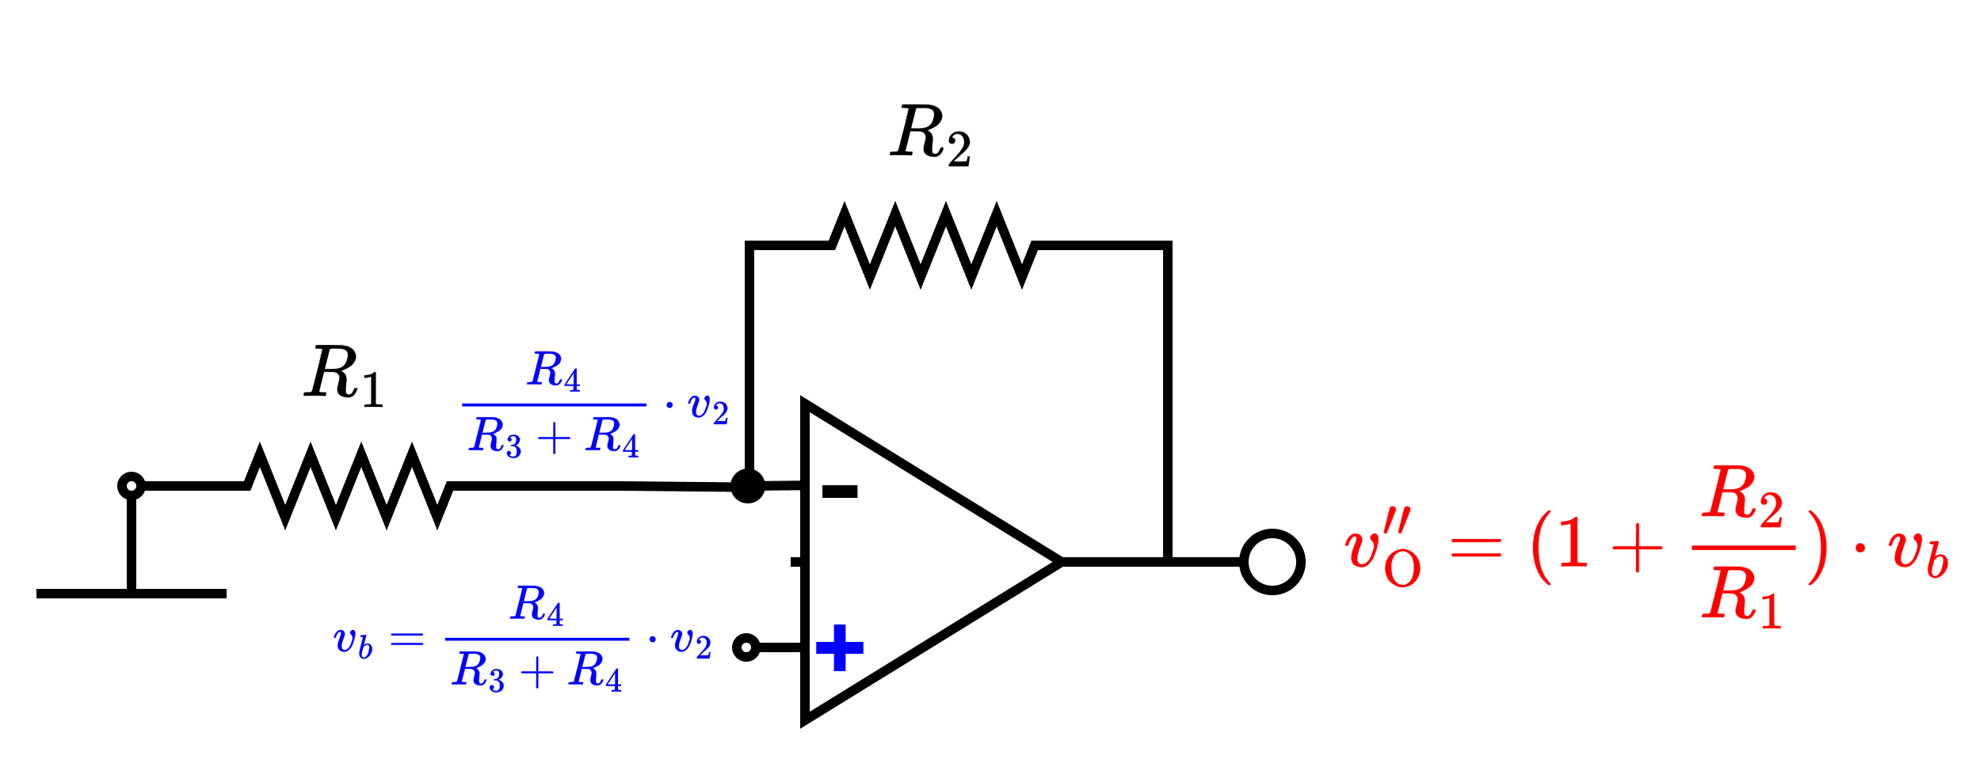
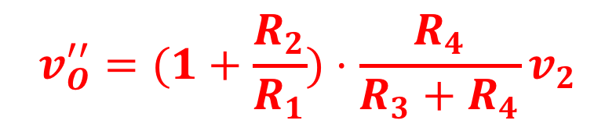
Difference Amplifier
Apply superposition principle:
+
$$v_{O}^{′′}=(1+\frac{R_{2}}{R_{1}})⋅\frac{R_{4}}{R_{3}+R_{4}}v_{2}$$

Slide 17
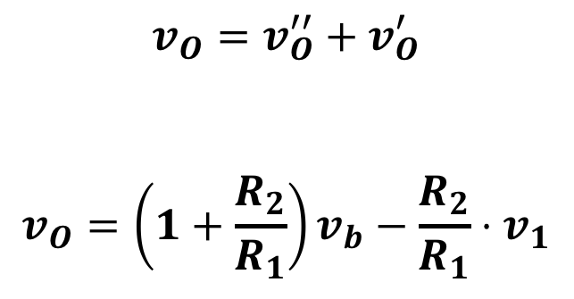
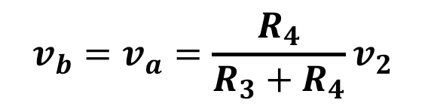
Difference Amplifier
$$v_{O}=v_{O}^{′′}+v_{O}^{′}$$
$$v_{O}=\left(1+\frac{R_{2}}{R_{1}}\right)v_{b}−\frac{R_{2}}{R_{1}}⋅v_{1}$$
$${v_{b}=v}_{a}=\frac{R_{4}}{R_{3}+R_{4}}v_{2}$$
$$v_{O}= (1+\frac{R_{2}}{R_{1}})⋅\frac{R_{4}}{R_{3}+R_{4}}v_{2}−\frac{R_{2}}{R_{1}}⋅v_{1}$$

Slide 18
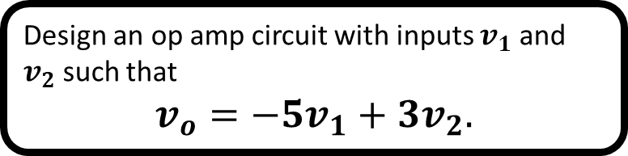
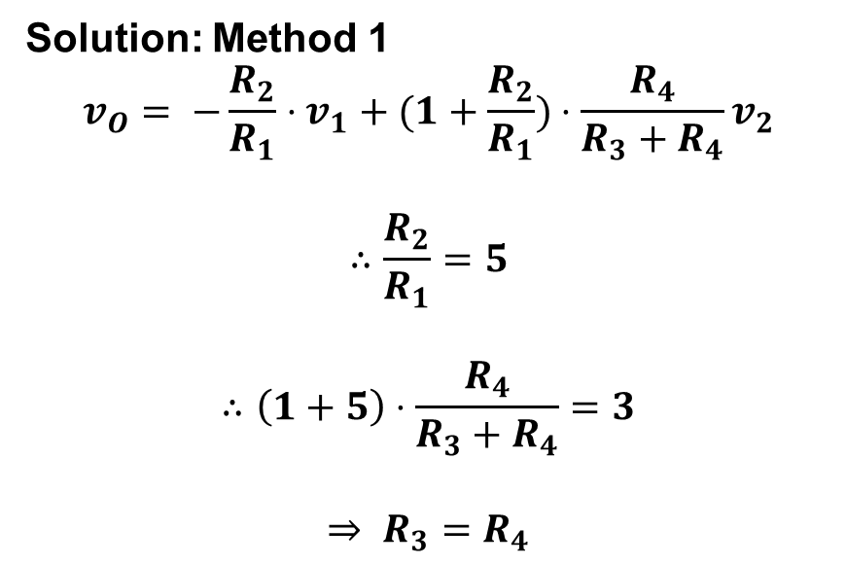
Difference Amplifier – Example 5
Design an op amp circuit with inputs $v_{1}$ and $v_{2}$ such that
$$v_{o}=−5v_{1}+3v_{2}.$$
Solution: Method 1
$$v_{O}= −\frac{R_{2}}{R_{1}}⋅v_{1}+(1+\frac{R_{2}}{R_{1}})⋅\frac{R_{4}}{R_{3}+R_{4}}v_{2}$$
$$∴\frac{R_{2}}{R_{1}}=5$$
$$∴\left(1+5\right)⋅\frac{R_{4}}{R_{3}+R_{4}}=3$$
$$⇒ R_{3}=R_{4}$$

Slide 20
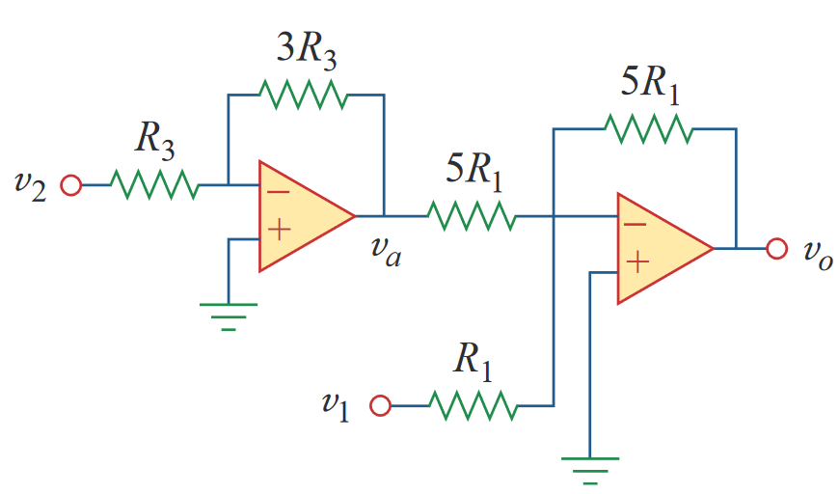
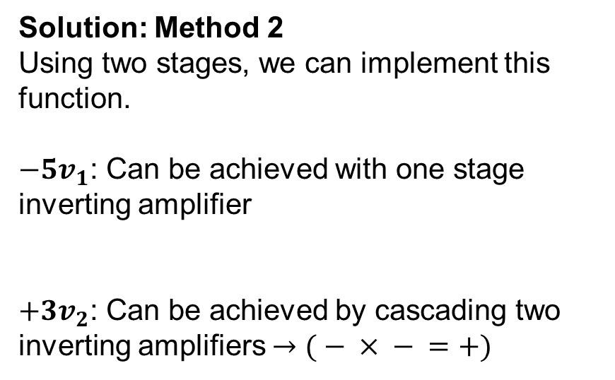
Difference Amplifier – Example 6
Design an op amp circuit with inputs $v_{1}$ and $v_{2}$ such that
$$v_{o}=−5v_{1}+3v_{2}.$$
Solution: Method 2
Using two stages, we can implement this function.
$−5v_{1}$: Can be achieved with one stage inverting amplifier
$+3v_{2}$: Can be achieved by cascading two inverting amplifiers $→( − × − =+)$

Slide 21

Subtractor ${(E}_{1}−E_{2})$

Slide 22
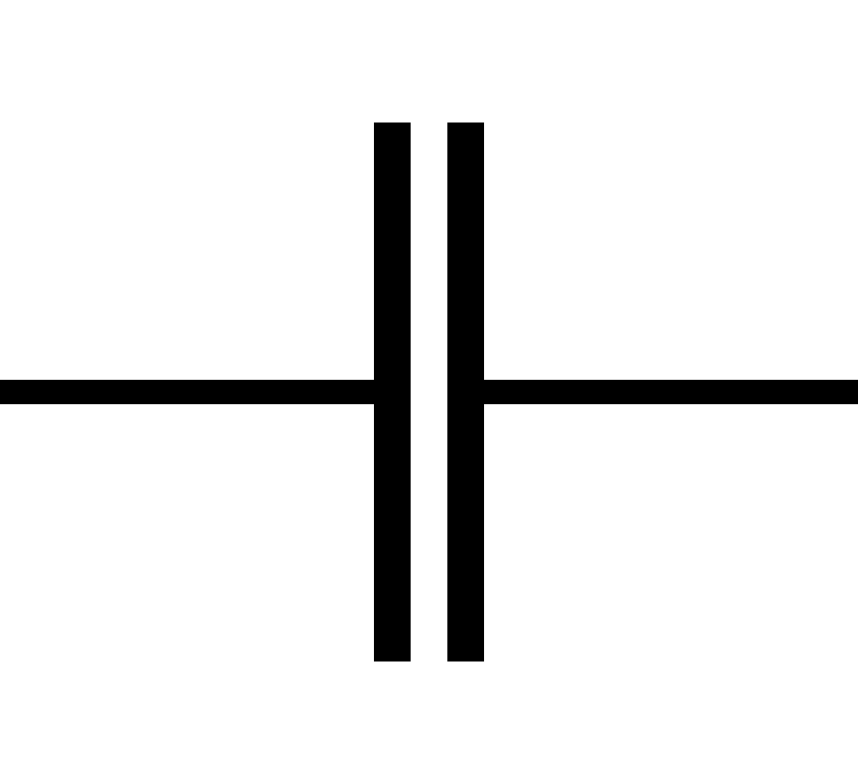
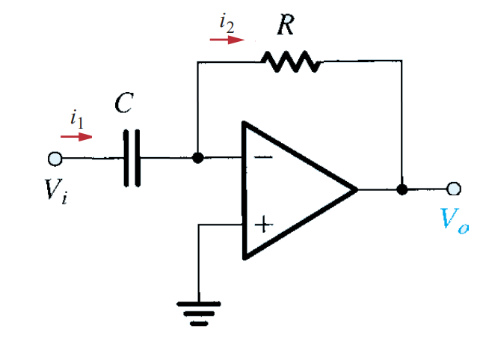


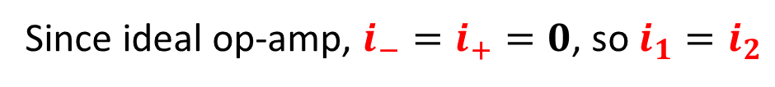
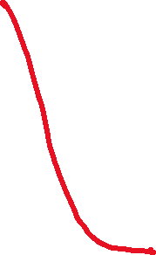

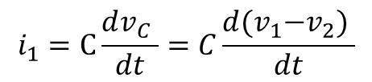











Op Amp as Differentiator
Review – Capacitor
Since ideal op-amp, $i_{−}=i_{+}=0$, so $i_{1}=i_{2}$
$$i_{1}$$
$$\frac{0−V_{O} }{R}$$
$$v_{1}$$
$$v_{2}$$
$$+$$
$$−$$
$$v_{C}$$
$$C\frac{d{(V}_{i}−0) }{dt}$$
$$i_{1}=C\frac{dv_{C} }{dt}=C\frac{d{(v}_{1}−v_{2}) }{dt}$$
$$0$$
$$i_{(−)}=0$$
$$⇒−\frac{V_{o}}{R}=C\frac{dV_{i} }{dt}$$
$$⇒ V_{O}=−RC\frac{dv_{i} }{dt}$$
$$0$$

Slide 23







Op Amp as Integrator
Review – Capacitor
Since ideal op-amp, $i_{−}=i_{+}=0$, so $i_{1}=i_{2}$
$$i_{1}$$
$$C\frac{d(0−V_{O}) }{dt}$$
$$v_{1}$$
$$v_{2}$$
$$+$$
$$−$$
$$v_{C}$$
$$\frac{V_{i}−\text{0} }{R}$$
$$i_{1}=C\frac{dv_{C} }{dt}=C\frac{d{(v}_{1}−v_{2}) }{dt}$$
$$0$$
$$i_{(−)}=0$$
$$⇒\frac{V_{i}}{R}=−C\frac{dV_{O} }{dt}$$
$$⇒ V_{O}=−\frac{1}{RC}∫V_{i}(t)dt$$
$$0$$

Slide 24

Example 8
Observe the following Figure. If $V_{i}$= $\text{5}⋅\text{sin}\text{(}\text{6}\text{t}\text{)}$, Find the value of $V_{0}$

Slide 25

Example 8
Observe the following Figure. If $V_{i}$= $\text{5}⋅\text{sin}\text{(}\text{6}\text{t}\text{)}$, Find the value of $V_{0}$
Solution:
This is a differentiator.
So,${ v}_{o}=−RC\frac{dV_{i} }{dt}=$ $−1×{10}^{6}×1×{10}^{−6}×\frac{d\left(\text{5}⋅\text{sin}\text{(6}\text{t}\text{)}\right) }{dt}$
$⇒{ v}_{o}$ $=$ $−1×\left(5×6\cos{(6t)}\right)=−30\cos{(6t})$ [Ans.]

Slide 26



















Example 9
$$V_{i}$$
$$V_{M}$$
$$t$$
$$\frac{T}{2}$$
$$T$$
$$\frac{3T}{2}$$
$$2T$$
$$\frac{5T}{2}$$
$$3T$$
$$−V_{M}$$
$$V_{O}$$
$$\frac{T}{2}$$
$$\frac{3T}{2}$$
$$\frac{5T}{2}$$
$$T$$
$$2T$$
$$3T$$
$$t$$
$$−\frac{V_{M}}{RC}⋅\frac{T}{2}$$

Slide 27




Example 9
$$V_{i}$$
$$V_{M}$$
$$t$$
$$−V_{M}$$
$$\frac{T}{2}$$
$$T$$
$$\frac{3T}{2}$$
$$2T$$
$$\frac{5T}{2}$$
$$3T$$
$$V_{O}$$
$$4RC⋅\frac{V_{M}}{T}$$
$$\frac{T}{2}$$
$$\frac{3T}{2}$$
$$\frac{5T}{2}$$
$$T$$
$$2T$$
$$3T$$
$$t$$
$$−4RC⋅\frac{V_{M}}{T}$$

Slide 28

Example 9
$$V_{i}$$
$$V_{M}$$
$$t$$
$$−V_{M}$$
$$\frac{T}{2}$$
$$T$$
$$\frac{3T}{2}$$
$$2T$$
$$\frac{5T}{2}$$
$$3T$$
$$V_{O}$$
$$4RC⋅\frac{V_{M}}{T}$$
$$\frac{T}{2}$$
$$\frac{3T}{2}$$
$$\frac{5T}{2}$$
Slope: $\left|\frac{dv}{dt}\right|=\frac{V_{M}−\left(−V_{M}\right)}{T/2}=\frac{4V_{M}}{T}$
$$T$$
$$2T$$
$$3T$$
$$t$$
$$−4RC⋅\frac{V_{M}}{T}$$

Slide 29

APPLICATIONS:
Implementing operational functions
$f=−2x−3y$
$f=−4x+5y$
$f=−7x+\frac{d}{dt}y$
$f=−\frac{1}{3}∫x⋅dt+2 ln y+4z$
$f=−3\frac{dx}{dt}+2\exp\left(y\right)+4z$
$f=xy/z$

Slide 30











APPLICATIONS:
Implementing operational functions
$f=−2x−3y$

Slide 31

















APPLICATIONS:
Implementing operational functions
$f=−4x+5y$

Slide 32

APPLICATIONS:
Implementing operational functions
$f=−7x+\frac{d}{dt}y$

Slide 33











APPLICATIONS:
Implementing operational functions
$f=−7x+\frac{d}{dt}y$

Slide 34

Example
Analyze the circuit below to find an expression of f in terms of inputs x and y.

Slide 35

Example
Analyze the circuit below to find an expression of f in terms of inputs x and y.
Solution:
$v_{f1}=−\frac{dy }{dt};v_{f2}=−\frac{1}{RC}\int{x dt};v_{f3}=−v_{f1}=\frac{dy }{dt}; {v_{o}=−(v}_{f1}$+$v_{f2}$+$v_{f3}$)

Slide 36


Exponential (Anti-log) Converter
$$I_{f}=I_{S}\exp\left(\frac{V_{i}−0}{V_{T}}\right)$$
$$\frac{0−V_{O}}{R_{f}}=I_{S}exp⁡(\frac{V_{i}}{V_{T}})$$
$$V_{O}=I_{s}R_{f}⋅exp⁡(\frac{V_{i}}{V_{T}})$$

Slide 37


Logarithmic Amplifier
$$I_{f}=I_{S}\exp\left(−\frac{V_{O}}{V_{T}}\right)$$
$$\frac{V_{i}}{R_{1}}=I_{S}exp⁡(−\frac{V_{O}}{V_{T}})$$
$$\frac{V_{i}}{I_{s}R_{1}}=exp⁡(−\frac{V_{O}}{V_{T}})$$
$$V_{O}=−V_{T}⋅ln\left(\frac{V_{i}}{I_{S}R_{1}}\right)$$

Slide 38

APPLICATIONS:
Implementing operational functions
$f=−\frac{1}{3}∫x⋅dt+2 ln y+4z$

Slide 39

APPLICATIONS:
Implementing operational functions
$f=−3\frac{dx}{dt}+2\exp\left(y\right)+4z$

Slide 40

Multiplier
$$f=xy$$
$$\ln{(f)}=\ln\left(xy\right)=\ln\left(x\right)+\ln\left(y\right)$$
$$f=\exp\left(\ln\left(x\right)+\ln\left(y\right)\right)$$
So,
$f=\exp\left(z\right)$ where $z=\ln\left(x\right)+\ln\left(y\right)$

Slide 41

Divider
$$f=xy/z$$
$$\ln{(f)}=\ln\left(xy/z\right)=\ln\left(x\right)+\ln\left(y\right)−\ln\left(z\right)$$
$$f=\exp\left(\ln\left(x\right)+\ln\left(y\right)−\ln\left(z\right)\right)$$
So,
$f=\exp\left(z\right)$ where $z=\ln\left(x\right)+\ln\left(y\right)−\ln\left(z\right)$

Slide 42


Slide 43

APPLICATIONS:
Implementing operational functions
$f=xy/z$

